Slide 1
Compute and networking
Notes:
https://learn.microsoft.com/training/modules/describe-azure-compute-networking-services/

Slide 2
Case Study Fraud reported on a website which is hosted in Azure

Slide 3
1. Initial Response
Verify the fraud report and secure the environment.
Confirm the fraud claim by gathering details from the reporter (e.g., type of fraud, impacted users).
Immediately restrict access to affected systems if a breach or vulnerability is suspected.
Enable "Maintenance Mode" on the website to protect users while investigating.

Slide 4
2. Identify the Scope of the Incident
Assess what data or systems are compromised.
Use Azure Monitor logs and Application Insights to track unusual activities like unauthorized logins, high-volume data exports, or abnormal API usage.
Review Azure Security Center recommendations for recent alerts or vulnerabilities.

Slide 5
3. Analyze User and System Activity
Look for patterns and anomalies.
Check Azure AD sign-in logs for suspicious login attempts, such as from unknown locations or IPs.
Use Azure Sentinel to correlate logs across services to identify how fraud was executed.

Slide 6
4. Contain the Threat
Stop ongoing fraudulent activities.
Block suspicious IPs or accounts using Azure Firewall and Azure AD Conditional Access.
Disable compromised user accounts or reset their credentials.
Shut down affected services or endpoints temporarily, if necessary.

Slide 7
5. Investigate Root Cause
Determine how the fraud occurred.
Audit recent code changes, configurations, or deployments in Azure DevOps.
Use Azure Defender for App Services to check for vulnerabilities like insecure code or missing updates.
Analyze database access logs for unauthorized data access or tampering.

Slide 8
6. Mitigation and Recovery
Apply fixes and restore services.
Patch software vulnerabilities, update misconfigured firewalls, or remove malicious scripts.
Restore data from a secure backup if tampering occurred, using Azure Backup or Azure Site Recovery.
Test the environment thoroughly before bringing the website back online.

Slide 9
7. Notify Stakeholders
Inform affected parties and regulatory bodies.
Notify impacted users about the fraud, steps taken, and guidance on mitigating personal risks (e.g., password reset).
Report the incident to compliance authorities if required by laws like GDPR.

Slide 10
8. Strengthen Security Posture
Prevent future fraud attempts.
Implement advanced threat detection using Azure Sentinel and Defender.
Enable multi-factor authentication (MFA) for all users in Azure AD.
Use Web Application Firewall (WAF) to filter malicious traffic.
Regularly test your website for vulnerabilities using tools like Azure DevOps Security Scans..

Slide 11
9. Monitor Post-Incident
Keep an eye on suspicious activity.
Set up automated alerts in Azure Monitor for any unusual behavior or potential repeat attacks.
Conduct regular audits of logs and security configurations.

Slide 12
10. Documentation and Lessons Learned
Record the incident and improve response plans.
Document all actions taken during the investigation and recovery.
Update your incident response plan based on insights gained.
Train your team on the identified vulnerabilities and solutions.

Slide 13
Case Study Fraud reported on an Alibaba Cloud website How Azure Can Help with a Non-Azure Hosted Website?

Slide 14
1. Centralized Threat Detection (Azure Sentinel)
Use Case: Integrate Alibaba Cloud logs with Azure Sentinel for advanced threat detection and analysis.
Benefit: Azure Sentinel can correlate data from multiple sources, including Alibaba Cloud, to detect complex fraud patterns and suspicious behavior.
Who.is?

Slide 15
2. Behavior Analytics and Machine Learning (Azure Machine Learning)
Use Case: Use Azure Machine Learning to analyze historical data from the website and detect abnormal patterns that could indicate fraud.
Benefit: Azure’s ML models can identify fraudulent behavior and alert teams to mitigate threats early.

Slide 16
3. Incident Response Automation (Azure Logic Apps)
Use Case: Automate incident response actions such as alerting stakeholders, blocking IPs, or triggering workflows to investigate fraudulent activities.
Benefit: Reduces response time and ensures systematic, consistent actions during fraud mitigation.

Slide 17
4. Threat Intelligence Sharing (Microsoft Threat Intelligence)
Use Case: Leverage Azure’s threat intelligence to compare known attack indicators with those from the Alibaba Cloud-hosted website.
Benefit: Provides a global view of potential threats and malicious IP addresses, aiding in faster identification of fraud tactics.

Slide 18
5. Secure Evidence Storage (Azure Key Vault)
Use Case: Securely store and manage sensitive data or evidence gathered during the investigation (e.g., logs, credentials).
Benefit: Azure Key Vault ensures evidence is protected with encryption, allowing only authorized personnel to access it.

Slide 19
6. Cross-Platform Log Aggregation (Azure Monitor)
Use Case: Use Azure Monitor to aggregate logs from both Alibaba Cloud and any other integrated systems (e.g., external APIs, on-premises servers).
Benefit: Provides a centralized platform for monitoring, allowing for more efficient fraud detection and investigation across environments.

Slide 20


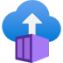


Azure compute services
Azure compute is an on-demand service that provides computing resources such as disks, processors, memory, networking, and operating systems.
Virtual
Machines
App
Services
Container Instances
Azure Kubernetes Services (AKS)
Azure Virtual Desktop
Notes:
https://azure.microsoft.com/products/category/compute/

Slide 21
Azure virtual machines
Azure virtual machines (VMs) are software emulations of physical computers.
Includes virtual processor, memory, storage, and networking.
IaaS offering that provides total control and customization.
Notes:
https://learn.microsoft.com/training/modules/describe-azure-compute-networking-services/2-virtual-machines
Development and test: Azure VMs offer a quick and easy way to create a computer with specific configurations required to code and test an application.
Applications in the cloud: Because demand for your application can fluctuate, it might make economic sense to run it on a VM in Azure. You pay for extra VMs when you need them and shut them down when you don’t.
Extended datacenter: Virtual machines in an Azure virtual network can easily be connected to your organization’s network.
Azure virtual machines: https://azure.microsoft.com/en-us/services/virtual-machines/

Slide 22

VM scale sets
Scale sets provide a load-balanced opportunity to automatically scale resources.
Scale out when resource needs increase.
Scale in when resource needs are lower.
Notes:
https://learn.microsoft.com/training/modules/describe-azure-compute-networking-services/2-virtual-machines

Slide 23
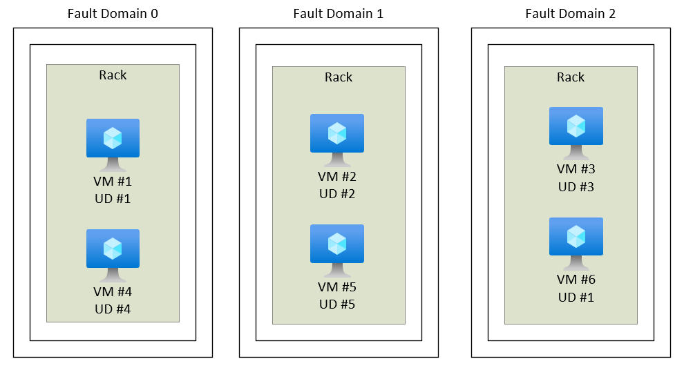
VM availability sets
Notes:
https://learn.microsoft.com/training/modules/describe-azure-compute-networking-services/2-virtual-machines
Update domain keeps VMs grouped if they can be rebooted at the same time without causing an outage.
Fault domains group VMs based on common power and networking.

Slide 24
Azure Virtual Desktop
Azure Virtual Desktop is a desktop and app virtualization that runs in the cloud.
Create a full desktop virtualization environment without having to run additional gateway servers.
Reduce risk of resource being left behind.
True multisession deployments.
Notes:
https://learn.microsoft.com/training/modules/describe-azure-compute-networking-services/4-virtual-desktop
https://learn.microsoft.com/azure/virtual-desktop/overview

Slide 25
Docker

Slide 26

What is Docker?
Virtualization Software
Makes developing and deploying applications much easier
Packages applications with all the necessary dependencies, configuration, system tools, and runtime.

Slide 27

Development process before Containers
Each developer needs to install and configure all services directly on their local machine.
Installation process different for each OS environment.
Multiple steps of installation, something can go wrong.

Slide 28

Development process with Containers
No need to install anything on machine.
Own isolated environment
Packaged with all dependencies and configs
Start service as Docker container
Command same for all OS
Command same for all services
Easy to run different versions of same app

Slide 29
Deployment process before Containers
Process:
Development team provides artifacts and instructions to Ops team
Ops team handles installing and configuring apps and its dependencies
Problem:
Installations and configurations done directly on Server
Dependency version conflicts
Miscommunication
Human errors

Slide 30
Deployment with Containers
Process:
Development create app package including all dependencies.
Docker artifact includes everything that app needs.
Instead textual, everything is packaged inside Docker artifact.
No configurations needed on the server
Ops teams only needs to run a Docker command

Slide 31




How OS is made up of?
OS Applications Layer
OS Kernel
VM
Hardware

Slide 32
Virtual Machine vs Docker
VM
Docker images, couple of MB
Containers take seconds to start
Compatible only with Linux (Docker desktop for Windows and Mac)
VM images, couple of GB
VMs take minutes to start
VM is compatible with all OS

Slide 33

Azure container services
Azure containers provide a lightweight, virtualized environment that does not require operating system management, and can respond to changes on demand.
Azure Container Instances: A PaaS offering that runs a container or pod of containers in Azure.
Azure Container Apps: A PaaS offering, like container instances, that can load balance and scale.
Azure Kubernetes Service: An orchestration service for containers with distributed architectures and large volumes of containers.
Notes:
https://learn.microsoft.com/training/modules/describe-azure-compute-networking-services/5-containers
Containers are a virtualization environment. However, unlike virtual machines, you do not manage an operating system. Containers are meant to be lightweight, and are designed to be created, scaled out, and stopped dynamically.
Azure Container Instances: https://azure.microsoft.com/en-us/services/container-instances/
Azure Kubernetes Service: https://azure.microsoft.com/en-us/services/kubernetes-service/
https://www.youtube.com/watch?v=pg19Z8LL06w

Slide 34
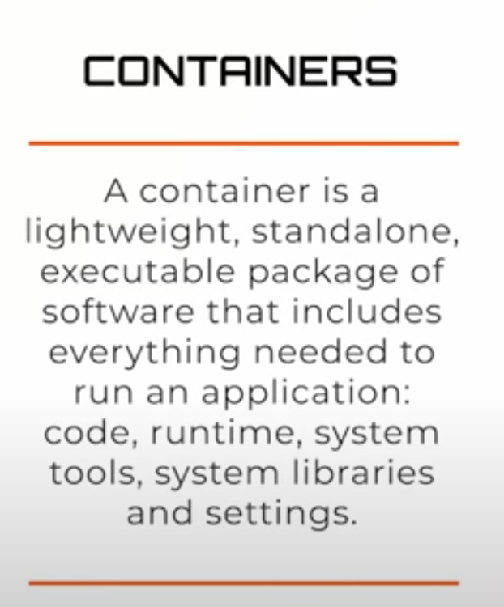
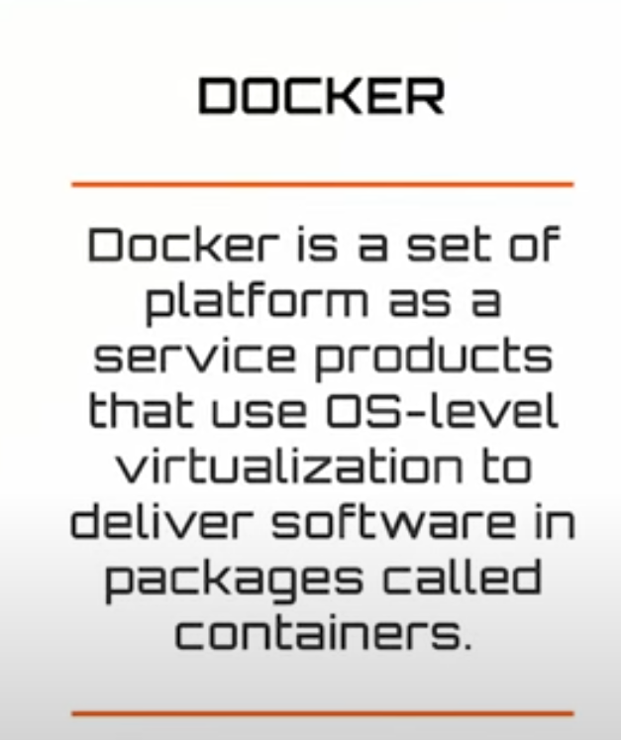
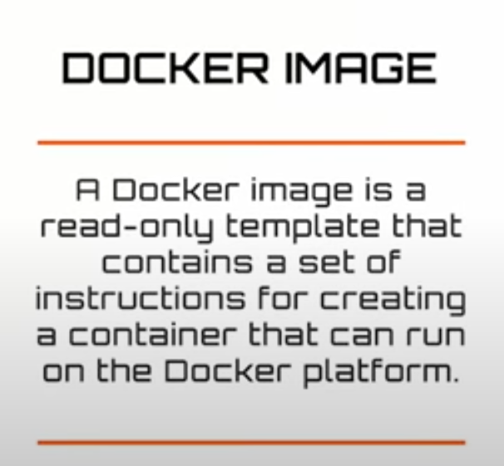
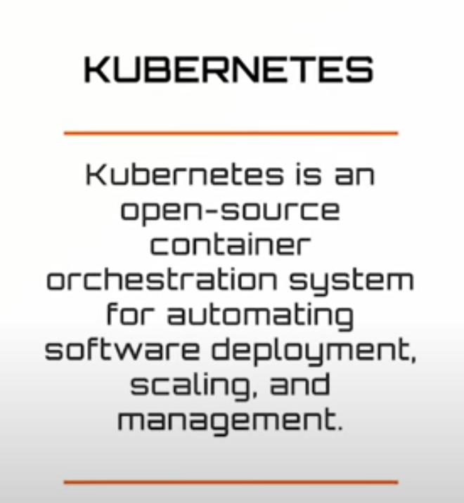

Slide 35
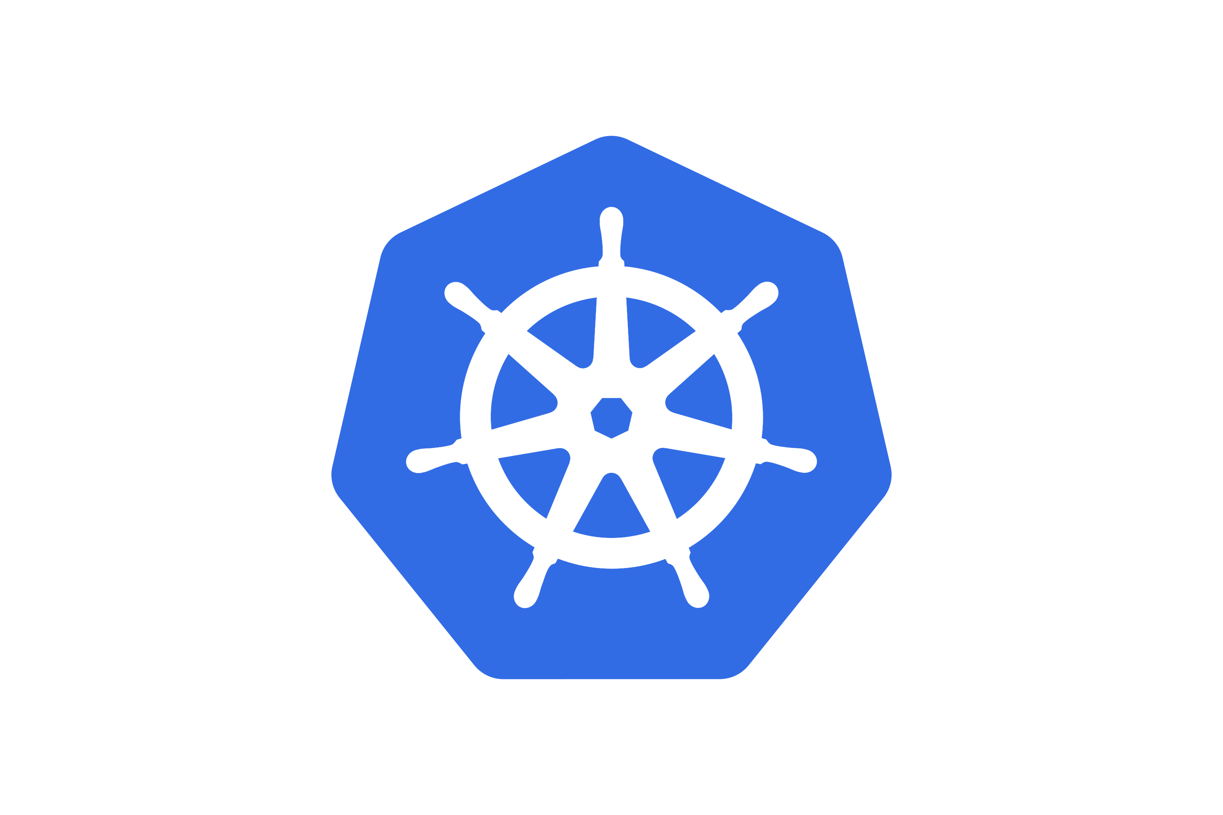

Slide 36
Docker vs Kubernetes
Docker is containerization platform that packages your application code, dependencies, and libraries into Containers.
These containers can run on any platform or OS that supports Docker
Full fledge application will have multiple containers for various components like Front-end, back-end, database, monitoring, logging, etc.
Managing these containers can be a challenging process.
For this we need container orchestration tool – Kubernetes.
Kubernetes manages multiple containers.
It helps with tasks like scaling containers up and down, ensuring high availability, distributing workloads, and make sure application runs smoothly all the time.

Slide 37

Azure Functions
Azure Functions: A PaaS offering that supports serverless compute operations. Event-based code runs when called without requiring server infrastructure during inactive periods.
Notes:
https://learn.microsoft.com/training/modules/describe-azure-compute-networking-services/6-functions
Serverless computing is the evolution of cloud platforms in the direction of pure cloud native code. Serverless brings developers closer to business logic while insulating them from infrastructure concerns. It's a pattern that doesn't imply "no server" but rather, "less server." Serverless code is event-driven. Code may be triggered by anything from a traditional HTTP web request to a timer or the result of uploading a file. The infrastructure behind serverless allows for instant scale to meet elastic demands and offers microbilling to truly "pay for what you use." Serverless requires a new way of thinking and approach to building applications and isn't the right solution for every problem.
Azure Functions is code that runs your service and not the underlying platform or infrastructure. Creates infrastructure based on an event.

Slide 38

Azure App Services
Azure App Services is a fully managed platform to build, deploy, and scale web apps and APIs quickly.
Works with .NET, .NET Core, Node.js, Java, Python, or php.
PaaS offering with enterprise-grade performance, security, and compliance requirements.
Notes:
https://learn.microsoft.com/training/modules/describe-azure-compute-networking-services/7-describe-application-hosting-options

Slide 39
Storage
Notes:
https://learn.microsoft.com/training/modules/describe-azure-storage-services/

Slide 40
Storage―objective domain
Describe the benefits and usage
Compare Azure storage services.
Describe storage tiers.
Describe redundancy options.
Describe storage account options and storage types.
Identify options for moving files, including AzCopy, Azure Storage Explorer, and Azure File Sync.
Describe migration options, including Azure Migrate and Azure Data Box.
Notes:
https://learn.microsoft.com/training/modules/describe-azure-storage-services/1-introduction

Slide 41

Storage accounts
Must have a globally unique name.
Provide over-the-internet access worldwide.
Determine storage services and redundancy options.
Notes:
https://learn.microsoft.com/training/modules/describe-azure-storage-services/2-accounts

Slide 42
Storage redundancy
Redundancy configuration | Deployment | Durability
Locally redundant storage (LRS) | Single datacenter in the primary region | 11 nines
Zone-redundant storage (ZRS) | Three availability zones in the primary region | 12 nines
Geo-redundant storage (GRS) | Single datacenter in the primary and secondary region | 16 nines
Geo-zone-redundant-storage (GZRS) | Three availability zones in the primary region and a single datacenter in the secondary region | 16 nines
Notes:
https://learn.microsoft.com/training/modules/describe-azure-storage-services/3-redundancy

Slide 43





Azure storage services
Azure Blob: Optimized for storing massive amounts of unstructured data, such as text or binary data.
Azure Disk: Provides disks for virtual machines, applications, and other services to access and use.
Azure Queue: Message storage service that provides storage and retrieval for large amounts of messages, each up to 64 KB.
Azure Files: Sets up a highly available network file share that can be accessed by using the Server Message Block protocol.
Azure Tables: Provides a key/attribute option for structured nonrelational data storage with a schema-less design.
Notes:
https://learn.microsoft.com/training/modules/describe-azure-storage-services/4-describe-azure-storage-services

Slide 44
Storage service public endpoints
Storage service | Public endpoint
Blob Storage | https://<storage-account-name>.blob.core.windows.net
Data Lake Storage Gen2 | https://<storage-account-name>.dfs.core.windows.net
Azure Files | https://<storage-account-name>.file.core.windows.net
Queue Storage | https://<storage-account-name>.queue.core.windows.net
Table Storage | https://<storage-account-name>.table.core.windows.net

Slide 45
Azure storage access tiers
Hot | Cool | Cold | Archive
Optimized for storing data that is accessed frequently. | Optimized for storing data that is infrequently accessed and stored for at least 30 days. | Optimized for storing data that is infrequently accessed and stored for at least 90 days. | Optimized for storing data that is rarely accessed and stored for at least 180 days with flexible latency requirements.
Notes:
https://learn.microsoft.com/training/modules/describe-azure-storage-services/4-describe-azure-storage-services

